Slide 1

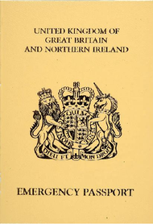
DO YOU NEED AN EMERGENCY TRAVEL DOCUMENT?
Have you lost your passport, had it stolen, has it expired or is it unavailable to allow you to travel urgently?
If you are a British Citizen and have held a British passport, you must apply and pay online for an Emergency Travel Document (ETD) using our on-line service
Just visit:
https://www.gov.uk/emergency-travel-document
You should also visit this website for details on how to apply if you are not a British Citizen but have held another type of British Nationality passport.

